Slide 1
CAPSTONE PROJECT
Movie Review & Discovery Platform
Presented By:
STU6832e63c770251748166204 (AICTE ID)
VEDASISTLA VENKATA SAI PAVAN KUMAR
B.TECH - COMPUTER SCIENCE & ENGINEERING
MADANAPALLE INSTITUTE OF TECHNOLOGY & SCIENCES

Slide 2
Problem Statement
Defining the core challenge without pre-empting solutions.
System Development Approach
Overview of the technological stack and environment.
Algorithm & Deployment
Step-by-step procedure of model implementation and deployment.
Result
Presentation of the predictive model's performance metrics.
Conclusion
Summary of findings and project implications.
References
List of sources and resources utilized.

Slide 3
Problem Statement
Fragmented Experience
Information Scatter
Movie enthusiasts lack a centralized, engaging platform for comprehensive film discovery
Existing tools scatter movie information, community ratings, and personal tracking across various sites
Inefficient Discovery
Difficult for users to efficiently discover, rate, and review films within
a single ecosystem
We need a modern web application to consolidate movie data, foster user interaction, and
provide attractive, community-driven insights to simplify viewing decisions. The goal is to
maximize engagement and serve as the definitive go-to source for film lovers.

Slide 4
System Approach
Layer
Component/Technology
Functionality
Presentation (Client-Side)
HTML, CSS, JavaScript
Manages the User Interface (UI), including the responsive layout, attractive design, search bar, filter buttons, and the interactive modal for reviews
Application Logic (Front-End JS)
JavaScript (Fetch API, DOM)
Handles all user actions (searches, clicks, form submissions), processes API data, calculates average ratings, and manages the local data storage
Data Storage
OMDB API, Local Storage
OMDB API provides external, read-only movie metadata (titles, plots, posters, IMDb ratings). Local Storage serves as the simple, persistent database for user-generated data (reviews, ratings)

Slide 5
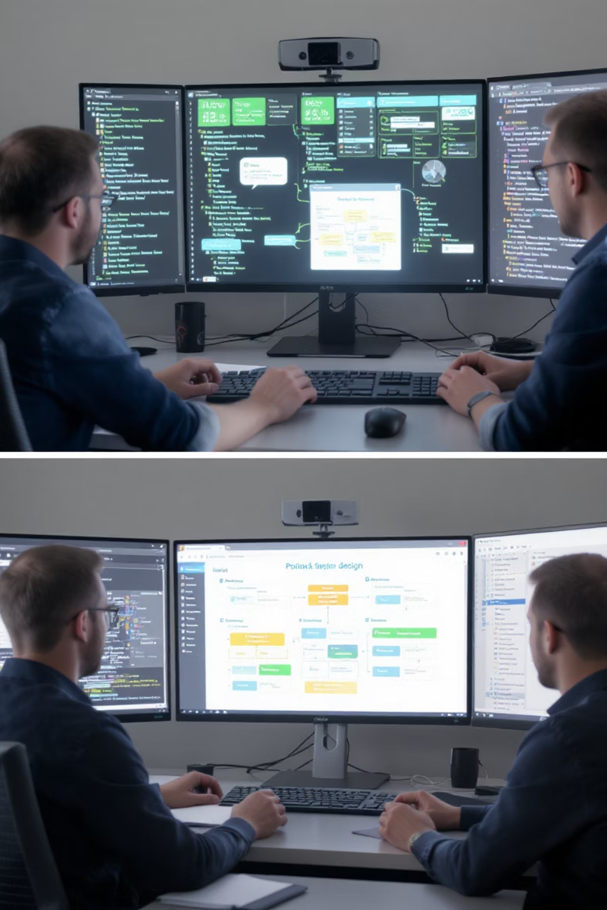
Algorithm & Deployment
Data Source Integration
This phase secures the platform's core information foundation. It involves defining the necessary API endpoints and obtaining credentials, specifically the OMDB API key, to enable comprehensive data retrieval from the world's largest movie database.
Critical to the success is implementing robust data management, which includes an asynchronous fetching algorithm (async/await) to overcome OMDB's per-request limits and fetch multiple pages of data for a rich initial display. Furthermore, this stage establishes the front-end's simple database: Local Storage is used to reliably persist all user-generated content, such as custom star ratings and text reviews, ensuring data availability every time a user revisits the site.

Slide 6
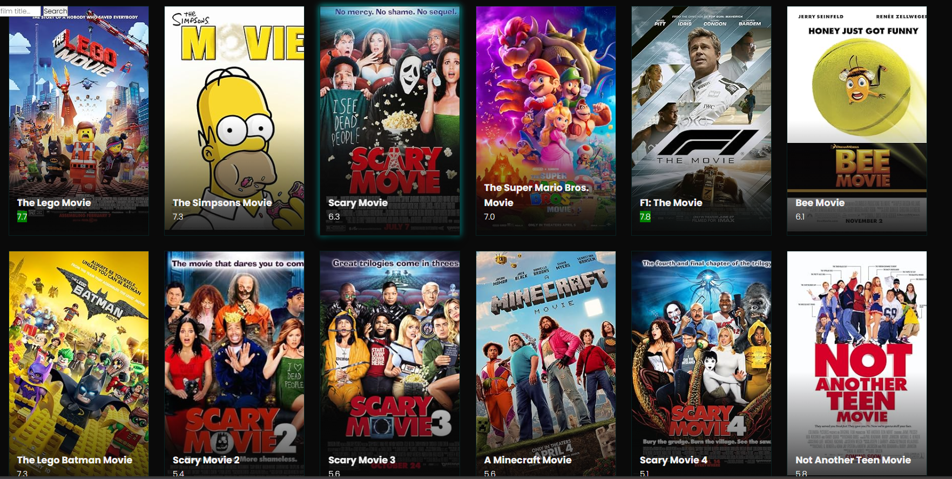
Frontend Design Excellence
Structural Foundation
Visual Appeal
The frontend design establishes the platform's attractive, professional presence. It begins with creating the necessary HTML structure for semantic integrity, encompassing the header, main content area, and modal components.
The core aesthetic relies on CSS to enforce a Dark Mode theme, utilizing vibrant accent colors (like cyan and gold) for visual appeal and enhanced user engagement.
A key structural element is the use of CSS Grid to create the highly desirable, responsive side-by-side card layout for the main movie catalog, guaranteeing an elegant and functional appearance across all mobile and desktop devices.

Slide 7
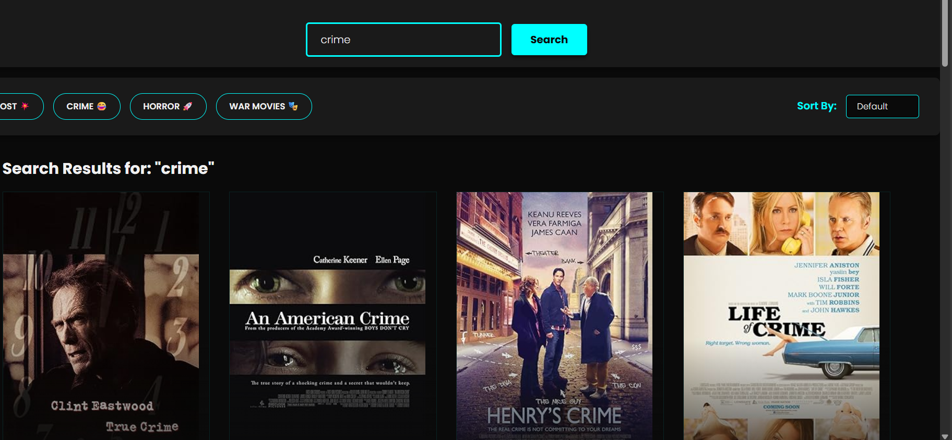



Interactive Features
Smart Filtering
Genre filter buttons and search bar trigger the data retrieval algorithm with specific queries, allowing users to discover targeted subsets of the movie catalog with precision.
Dynamic Modals
Upon clicking a movie, a modal view is presented, requiring JavaScript to asynchronously fetch detailed plot information and runtime data for comprehensive film details.
Community Scoring
The system implements the Community Score algorithm, calculating average ratings from Local Storage data in real time, and provides an interactive star rating interface for user contributions.

Slide 8




Comprehensive Testing
Mobile Responsiveness
Thoroughly tested CSS Grid layout scaling and interactive
elements usability on small screens
Cross-Browser Compatibility
Functionality verified across popular web browsers to
prevent layout or script errors
Data Persistence
Local Storage tested to ensure user reviews and ratings
are correctly saved and consistently displayed
The final phase ensures a high-quality user experience across various environments, guaranteeing that all features perform optimally regardless of the user's device or browser preference.

Slide 9
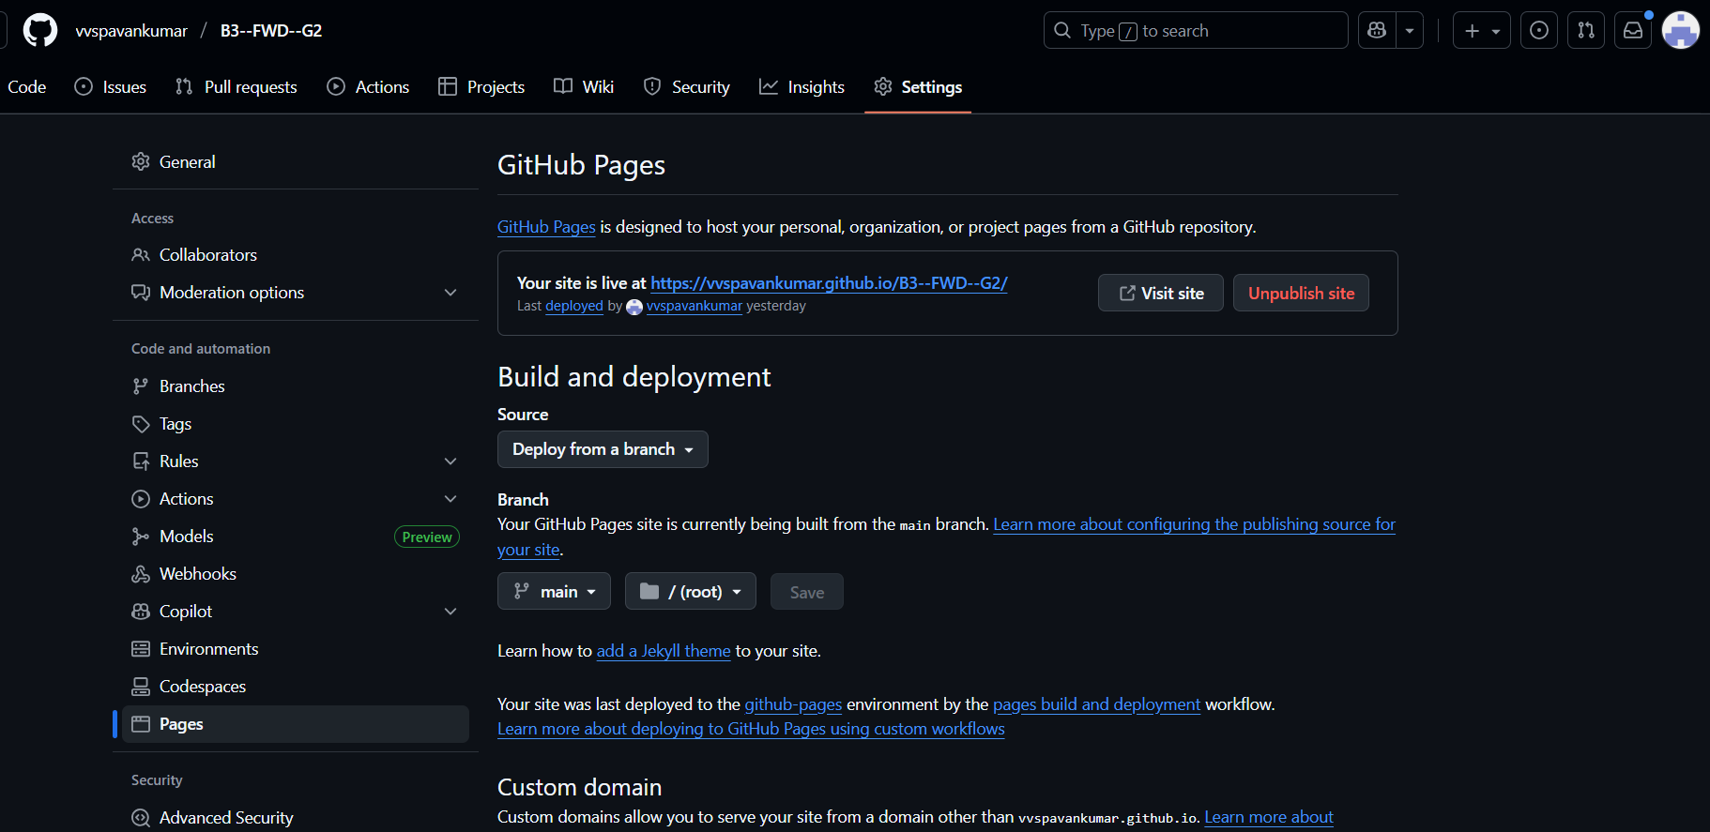
Deployment Strategy
Git Repository Setup
Initialize a Git repository locally and commit all source files for version
control
GitHub Integration
Push the project to a remote GitHub repository for
cloud-based hosting
GitHub Pages Activation
Activate GitHub Pages in repository settings, selecting the main
branch as deployment source
Continuous Deployment
Automatic updates to the live website within minutes of
code changes
Deploying the Movie Review and Discovery Platform is streamlined using Git and GitHub Pages. GitHub automatically serves the static files via a public URL, leveraging the browser's environment to execute JavaScript and handle OMDB API calls and Local Storage operations.

Slide 10
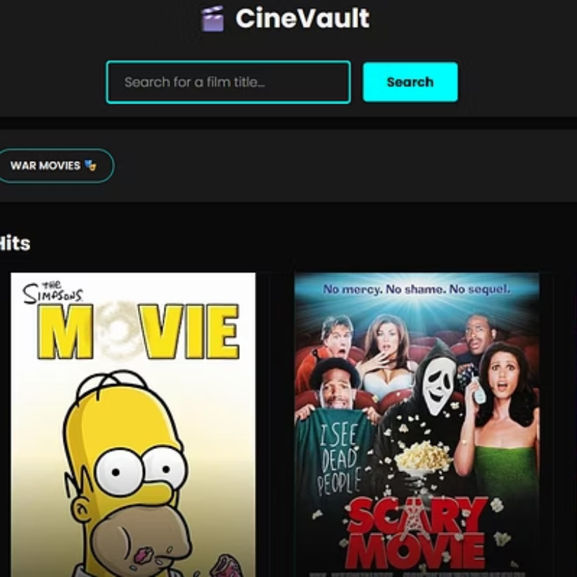
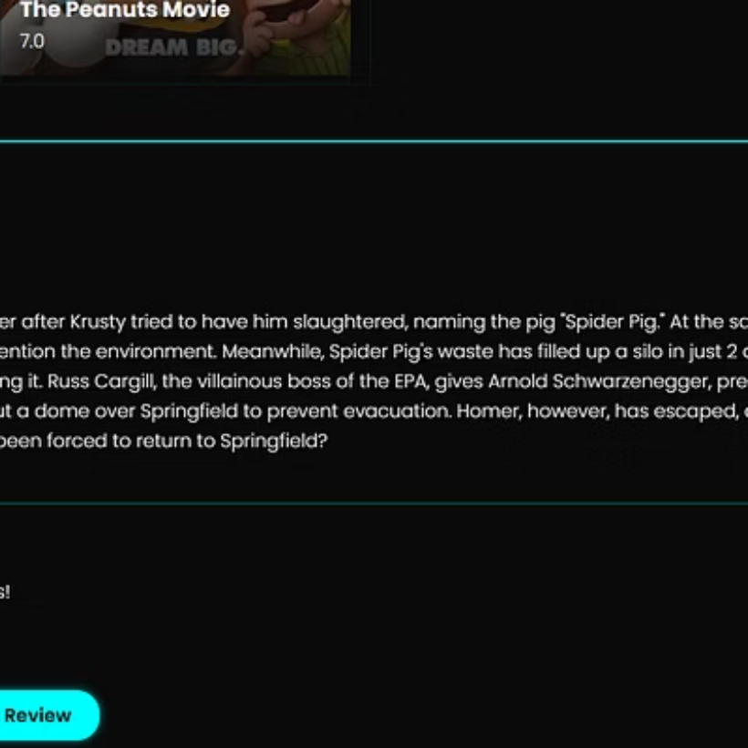
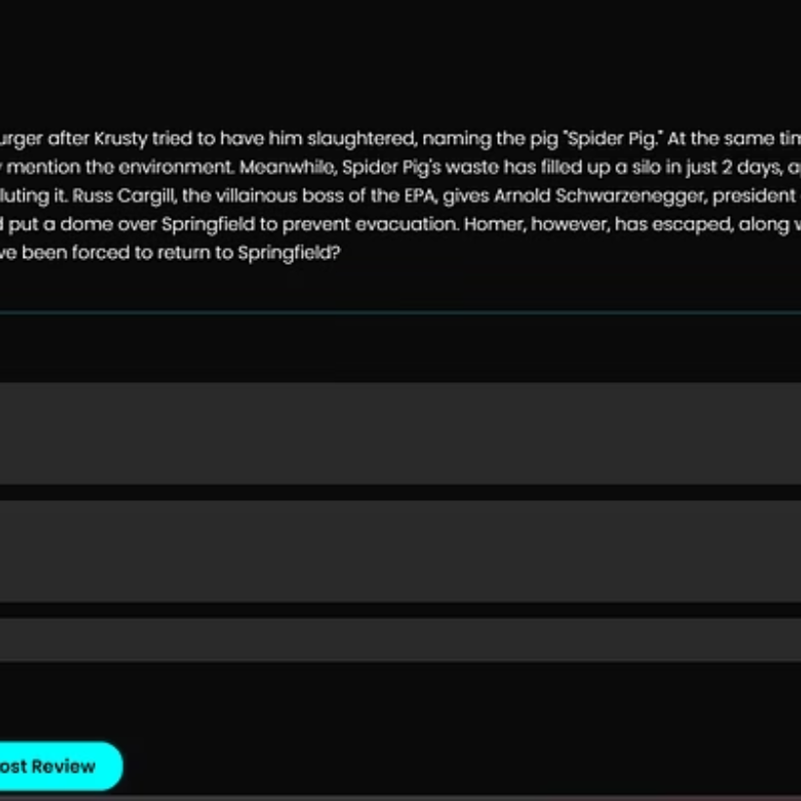
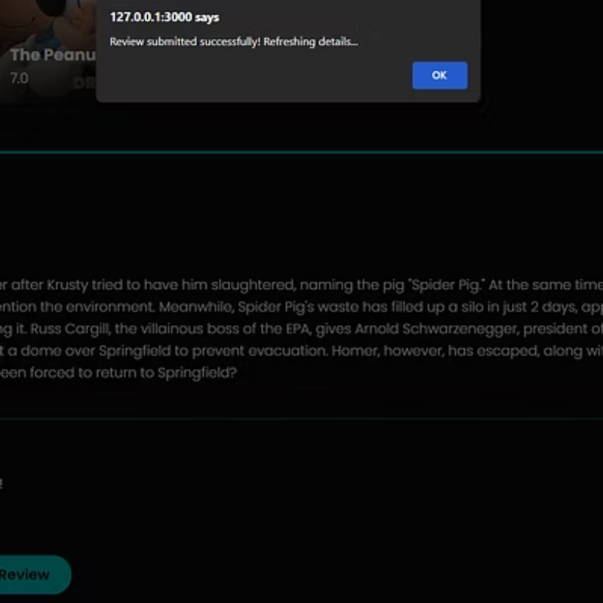
Project Results
The Movie Review and Discovery Platform successfully demonstrates a comprehensive web application that consolidates movie discovery, community engagement, and personal tracking in a single, elegant interface.
4 Core Technologies
HTML, CSS, JavaScript, OMDB API

Slide 11
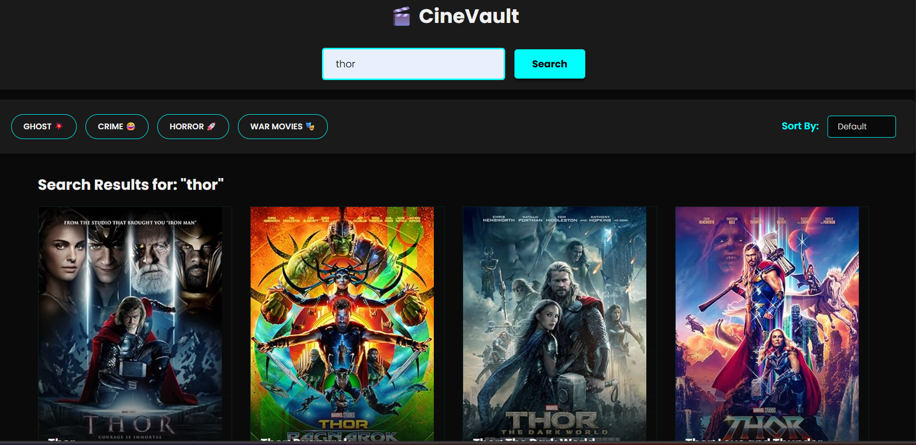
The platform successfully addresses the core problem of fragmented movie discovery experiences by providing a unified, engaging, and technically robust solution for film enthusiasts.

Slide 12
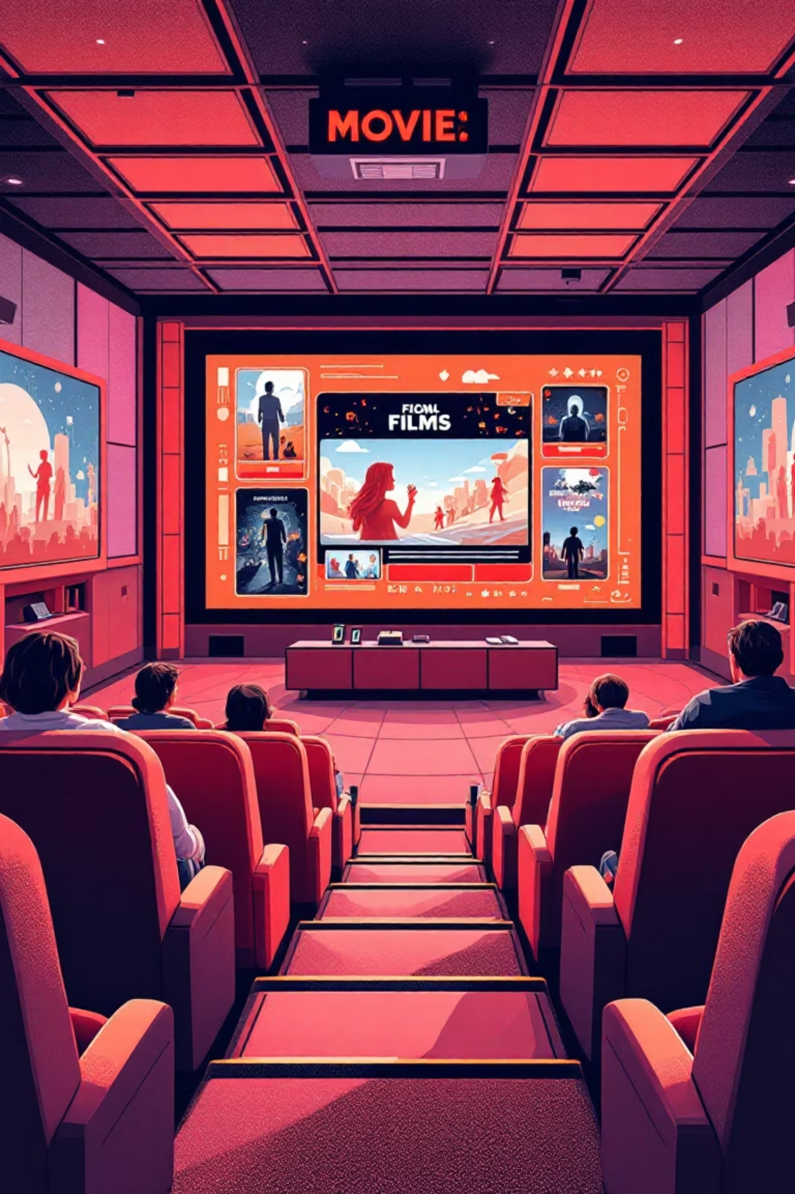
Movie Discovery Platform Deployment
GitHub Repository
Access the complete source code, documentation, and development history for this comprehensive movie discovery platform.
https://github.com/vvspavankumar/B3--FWD--G2.git
Live Deployment
Experience the fully functional platform with real-time movie data, community features, and interactive discovery tools.
https://vvspavankumar.github.io/B3--FWD--G2/
This movie discovery and community platform represents a sophisticated solution for film enthusiasts and small businesses looking to engage customers through entertainment content. The deployment demonstrates enterprise-level functionality with seamless integration of external APIs and local data storage.

Slide 13
Platform Impact & Business Value
Cost-Effective Digital Presence
Platform Independence
Enhanced Customer Experience
Provides small businesses with a professional online platform without the complexity and overhead costs of traditional e-commerce solutions. The streamlined architecture reduces maintenance requirements while delivering maximum user engagement.
Eliminates dependency on complex third-party e-commerce platforms, giving businesses full control over their digital presence and customer experience without ongoing subscription fees or vendor lock-in.
Delivers an engaging and interactive customer experience that keeps users actively participating rather than passively browsing, increasing time spent on platform and customer retention rates.
The successful implementation of the Movie Discovery and Community Platform fundamentally solves the fragmentation problem for film enthusiasts. By consolidating film data from the OMDB API with rich, user-generated ratings and reviews stored locally, the system achieves its core mission: to simplify the decision-making process for users deciding what to watch.
The platform's attractive, highly interactive design and immediate display of Community Average Scores directly foster the intended engagement, turning passive discovery into active participation. Ultimately, the system transforms the user experience by providing a single, definitive, and visually compelling hub where movie passion is shared, guiding users quickly and confidently to their next great film experience.

Slide 14



Technical References & Implementation
OMDB API Integration
Asynchronous Operations
Data Persistence
OMDB API Documentation served as the essential foundation for understanding data structure, endpoint usage, and implementing robust movie fetching and detail lookup functionality across the platform.
MDN Web Docs (JavaScript Fetch API) guided the implementation of sophisticated asynchronous logic using async/ await for multi-page retrieval and seamless card rating updates.
MDN Web Docs (Web Storage API) provided fundamental reference for implementing Local Storage solutions to persist user ratings and comments, creating the platform's lightweight database system.
Responsive Design Framework
Code Architecture
MDN Web Docs (CSS Grid & Transitions) guided the creation of the responsive layout architecture and attractive visual effects, including staggered animations and glowing focus states that enhance user interaction.
Principles of Modular JavaScript influenced the strategic organization of code into distinct, reusable functions, ensuring long-term maintainability and scalability for future enhancements.

Slide 15




THANK YOU
Successful Deployment
Community Ready
Your movie discovery platform is now live and ready to serve the film community
The platform is equipped to handle user engagement and foster movie discussions
Business Impact
A cost-effective solution that delivers professional results for small businesses
This presentation showcases a comprehensive movie discovery platform that successfully bridges the gap between film enthusiasts and small business needs. The deployment represents a scalable, maintainable solution that prioritizes user experience while maintaining technical excellence.

